Slide 1
Fit_My_Life (FML)
Group 21: Gobikah Balaruban, Nathan Bojczuk, Karanvir Bhogal, Manreet Kaur

Slide 2
Project Description
Almost everyone wants to live a healthy life and exercise regularly, but when it comes to actually implementing these habits, it is a lot more difficult than it seems. Fit_My_Life app is a fitness tracking app which will help the people to track their food intake and exercise so that they can keep healthy. To top it all off, users will be able to login with their own personal accounts so all of their fitness data stays safe and organized.

Slide 3
App Features
Record meals, calories, water
Find healthy recipes
Calculate BMI
Find workout routines
Set goals for workouts
Track Weight

Slide 4
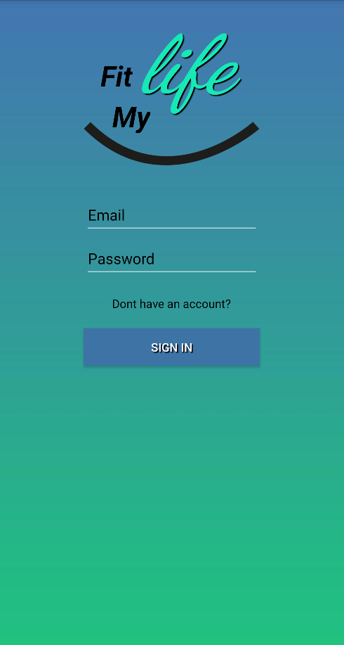
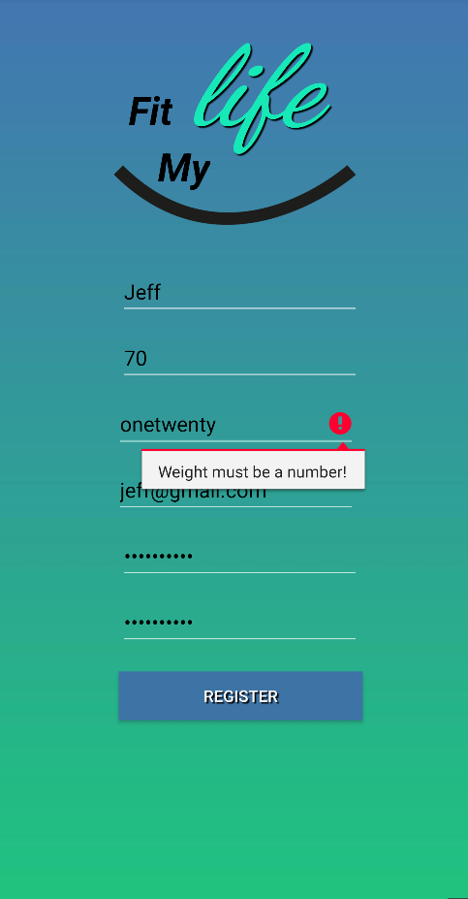
Login/Register
Input validation to prevent:
User Error
Hacker Injection

Slide 5
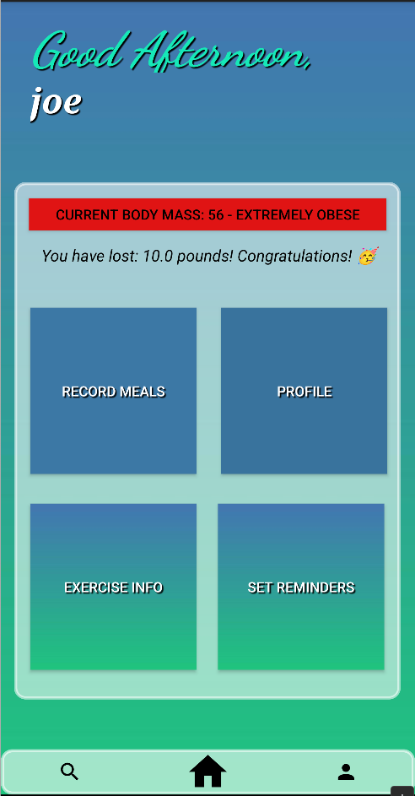
USER INTERFACE
Home screen is easy to use and displays key information.
Current BMI and how much weight you have lost is shown
Can easily access all functionality from this page

Slide 6
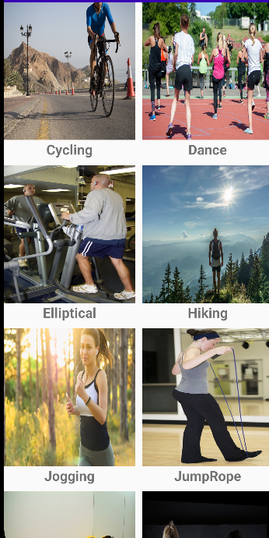
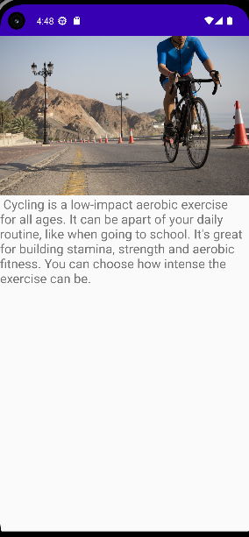
INTENTS
Multiple intents was used for browsing through exercises
If users want to learn more about the exercise and the benefits, they can click on it and they will be provided with a description of the exercise

Slide 7
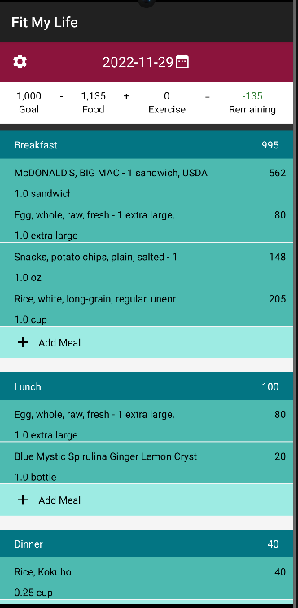
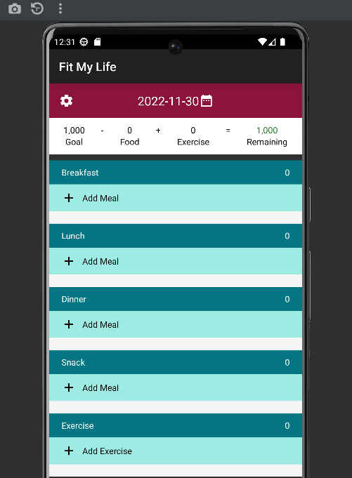
SAVE STATES
Here the meals , calories intake , food search and added in the breakfast and other date and all other related data is getting saved to the file using ObjectOutput Stream .
Then we the ObjectInputStream to recover the state of the meals , calories and other information that was saved using ObjectOuptutStream .

Slide 8
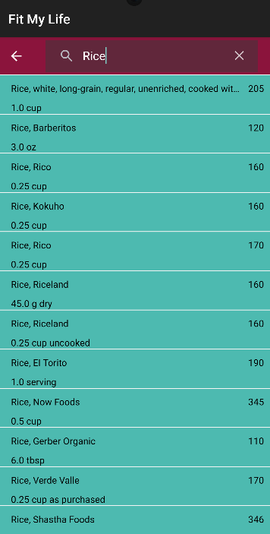
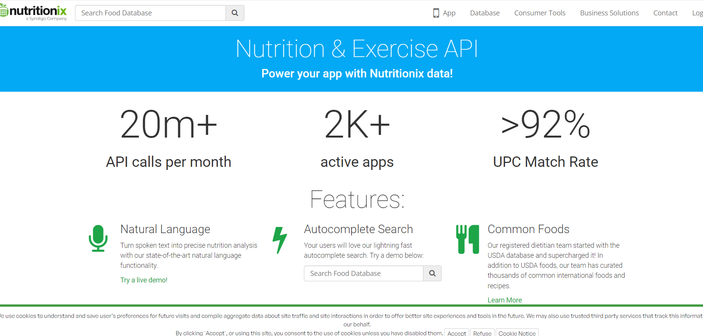
FOOD API
To search for the nutrition and meals we are using nutritionix API

Slide 9

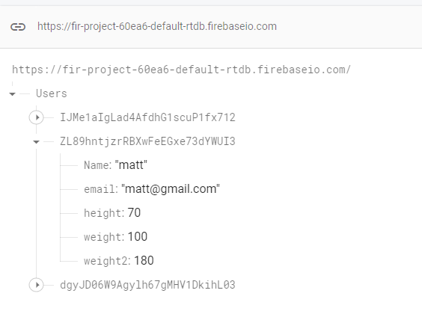
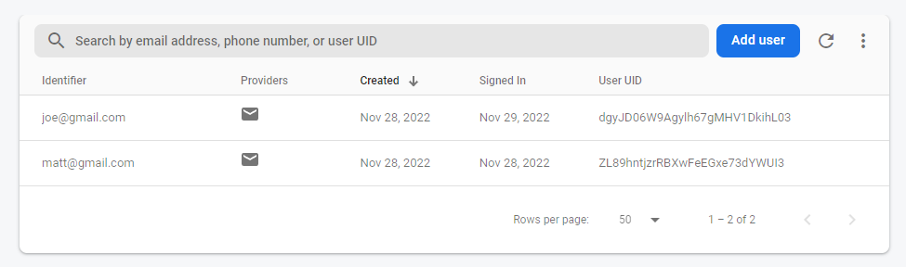
DATABASE
Realtime Database
Authentication

Slide 10
Demonstration

